Slide 1

EECE 350 Project
By: Georges Freiha, Mostafa Kassem,
Abdullah Itani, Nourhan Salam

Slide 2
Table of Contents:
Slide 4: Demo on a normal case
Slide 5:Demo on case where timeout occurs (Player doesn’t type the answer after 10 seconds
Slide 6: Demo where player inserts a number different than what is given
Slide 7: Demo where player disconnects in the middle of the game
N.B: All cases were tested using Visual Studio Code

Slide 3
Instructions
1-Run the server on one terminal
2-Run the client code on other terminals for the number of players (You can choose how many players you want)
3-Input the numbers and enjoy the game!
N.B: Make sure to download MP3 File to run the music.

Slide 4
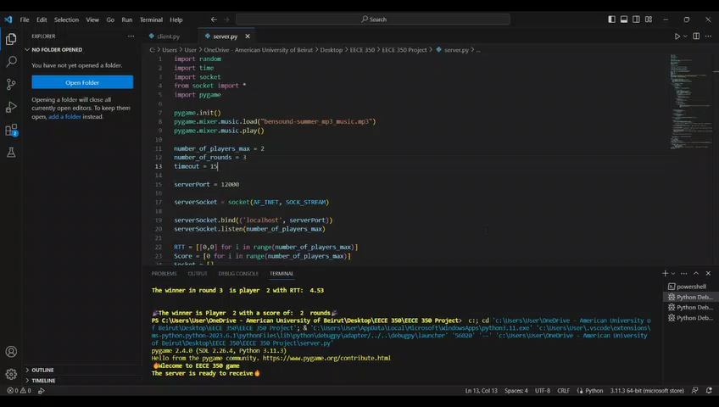
Normal Case

Slide 5
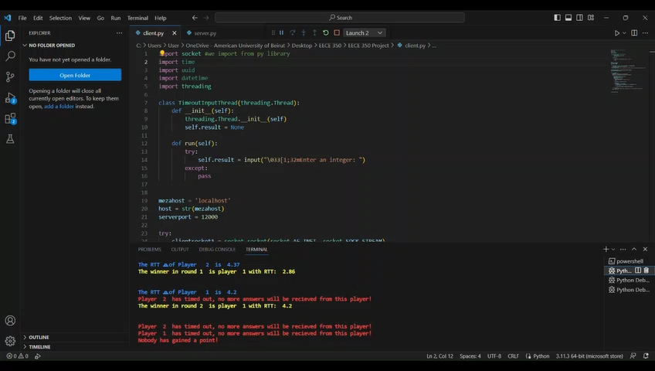
Timeout Case

Slide 6
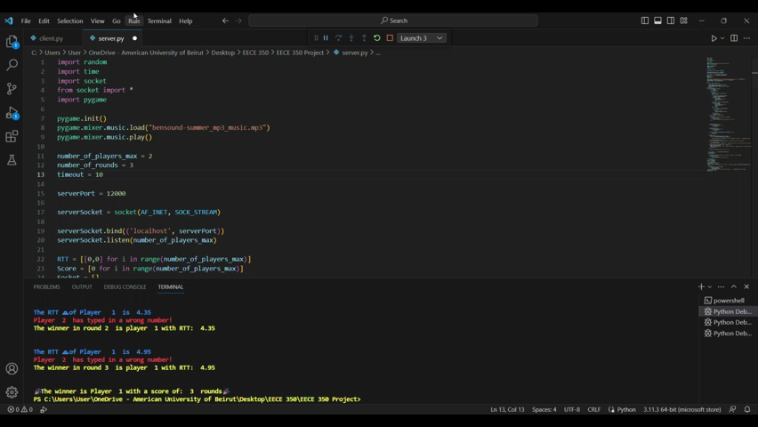
Wrong Input Case

Slide 7
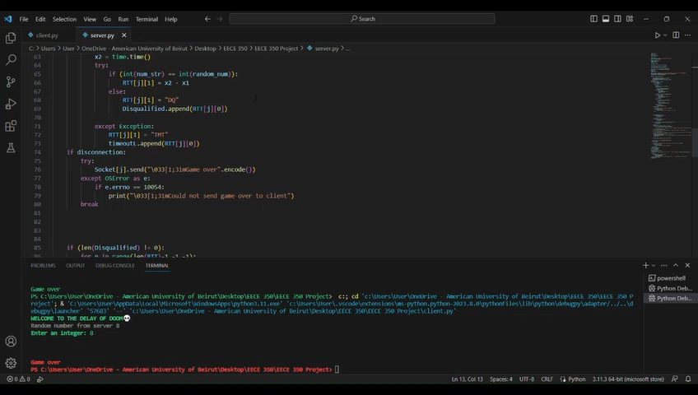
Disconnection case

